Slide 1
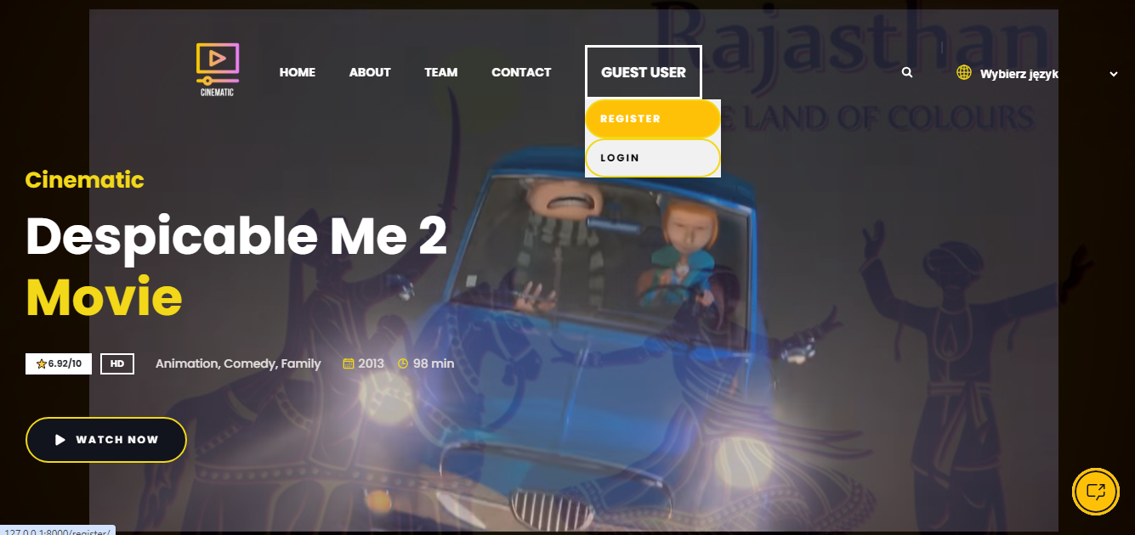
Movie Prediction System: Using Content-Based Filtering Approach
A brief overview of a movie prediction system using content-based filtering algorithm based on sklearn count vectorizer and cosine similarity distance matrix.
Created By Deepak Gangwani

Slide 2
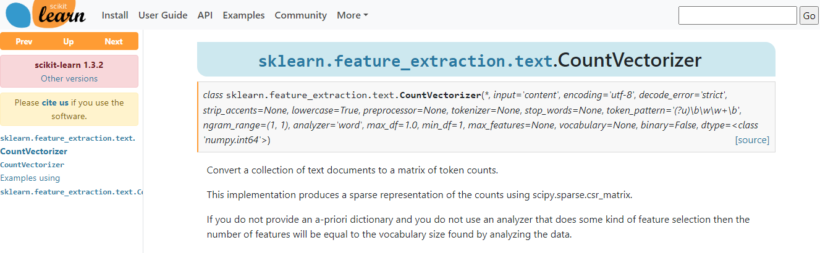
Exploring the Count Vectorizer and Cosine Similarity
1
Count Vectorizer
A tool used to transform textual data into a numerical representation that can be used to build a model.

Slide 3
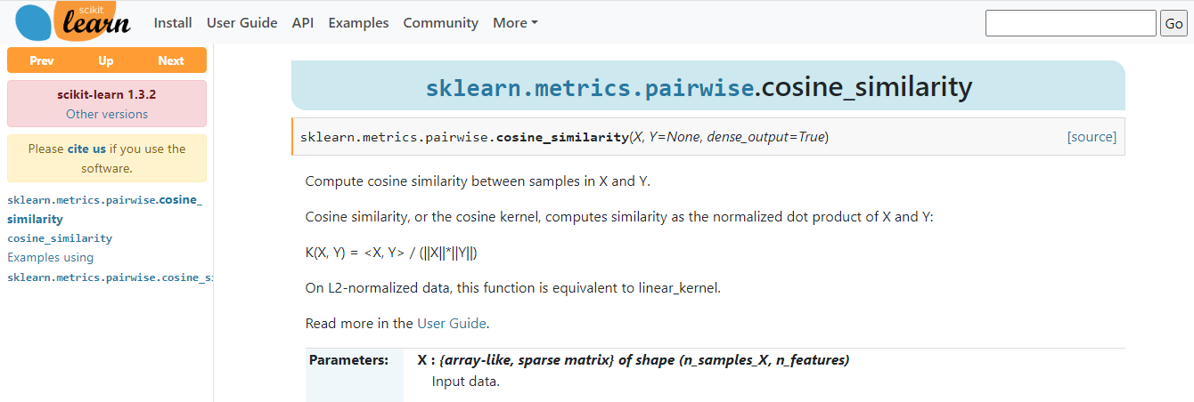
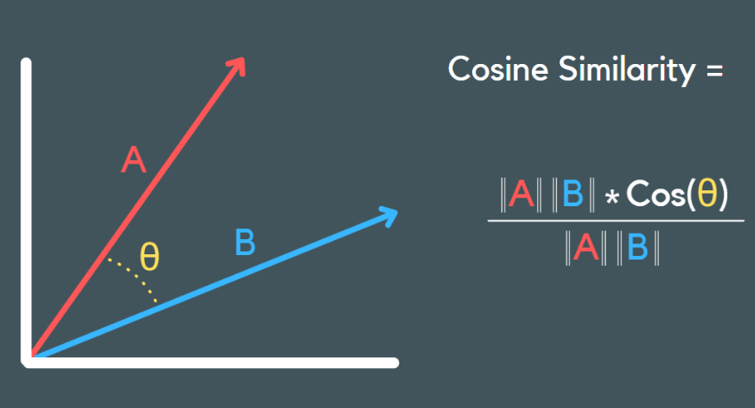
Exploring the Count Vectorizer and Cosine Similarity
2
Cosine Similarity
A tool used to transform textual data into a numerical representation that can be used to build a model.

Slide 4

Exploring the Count Vectorizer and Cosine Similarity
3
Algorithm
Our content-based filtering approach enables the recommender system to suggest movies based on similarities between their attributes and those of already-watched movies.

Slide 5

Technology Stack
Frontend Technologies
Backend Technologies
We used HTML, CSS, JS, jQuery, Bootstrap and a favicon to build our user-friendly interface.
We employed MySql and Python with the Django framework to build the backend logic of our system and admin panel.
Python Libraries
We used various python libraries such as numpy, pandas, pickle, sklearn, and nltk.

Slide 6

Social Impact
Personalized Movie Recommendations
Efficient Resource Allocation
Our movie recommender system helps people discover movies they will enjoy watching, leading to better entertainment experiences.
Our recommendation system can optimize the use of resources, such as server capacity and the user's time, by suggesting movies with a high probability of being enjoyed.
Reduced Wastage of Time and Money
Our system saves valuable time and money by suggesting only relevant movies to the user.

Slide 7
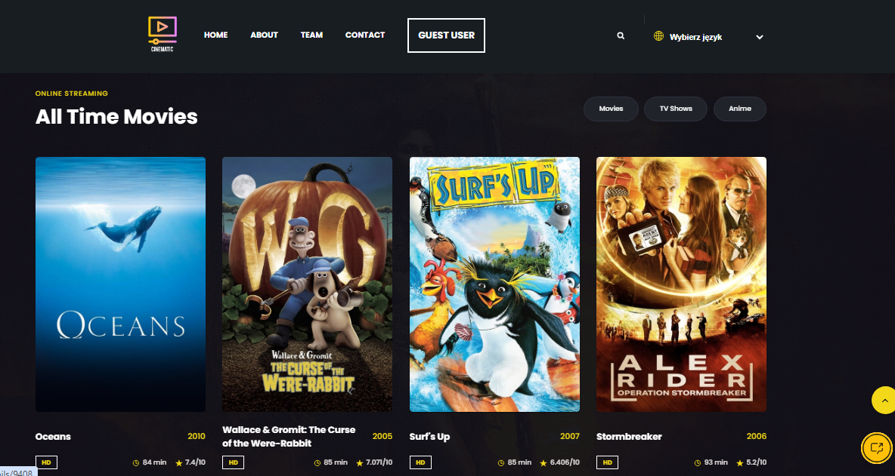
Our Wow Factor
1
Innovative Approach
2
Accuracy
3
Efficiency
Our system uses a unique content-based filtering algorithm to recommend movies that match the user's preferences and interests.
Our system suggests movies with higher accuracy compared to other recommendation systems using collaborative filtering approaches.
Our system can process vast amounts of data within a short time.

Slide 8
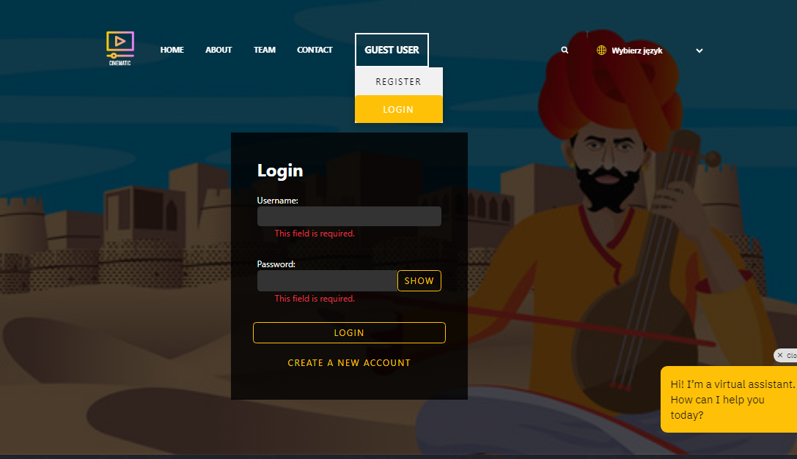
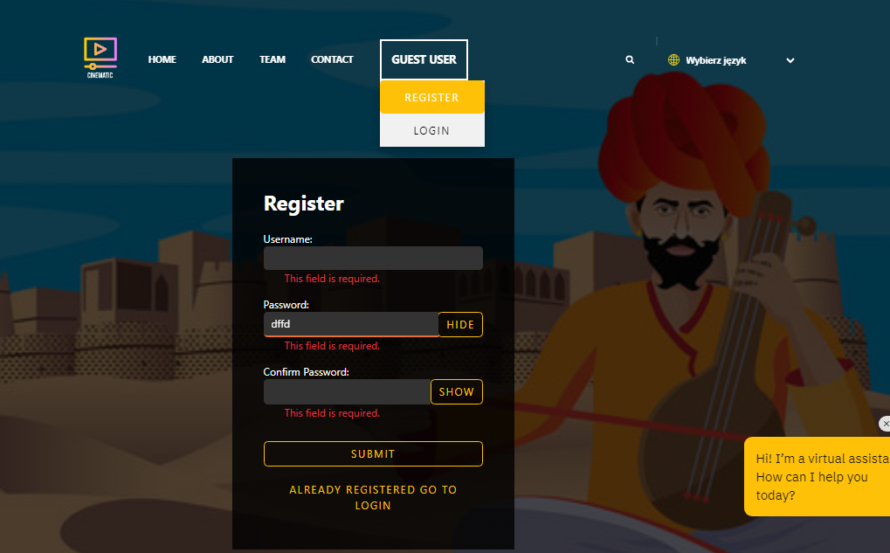
Authentication
1
User Accounts
2
Session Management
3
Secure Password Storage
Users can create individual accounts with unique usernames and passwords to access the movie prediction system.
Implementing session management techniques to manage user sessions securely, including session timeouts and re-authentication for sensitive actions.
Employing strong encryption techniques to securely store user passwords, such as hashing with a salt, to prevent unauthorized access to user credentials.

Slide 9
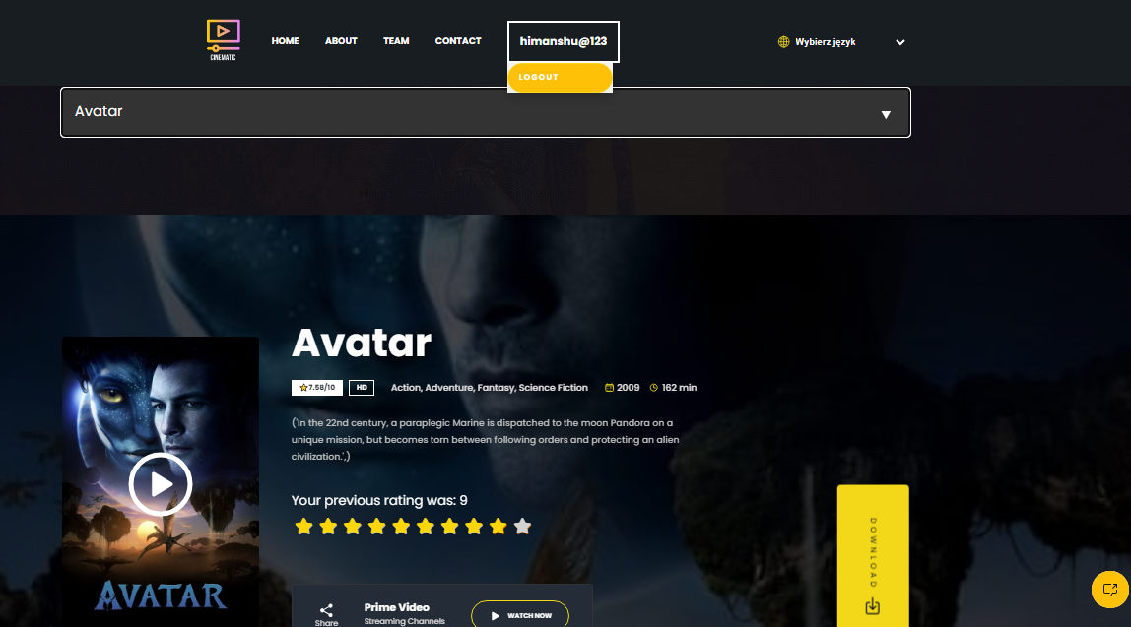
Authorization
1
Resource Based Authorization
Permission Levels
2
Access Control Lists(ACLs)
3
Each role is granted specific permissions, dictating what actions they can perform.
Defines access control policies for individual resources, specifying which users or groups are granted or denied access to each resource and what level of access they have.
Each role is associated with a set of permissions that determine which resources (such as movie data, user profiles, or system settings)

Slide 10
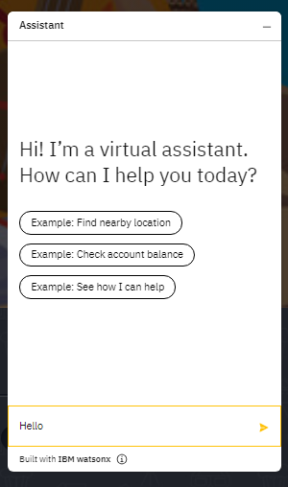
Watson Chat Bot Assistant
1
Natural Language Understanding (NLU)
Watson Assistant uses advanced NLU capabilities to understand and interpret user input in natural language. It can analyze user queries, extract intents (what the user wants) and entities (specific details mentioned in the query), and determine the appropriate response.
2
Dialog Flow Management
Watson Assistant allows developers to create conversational dialog flows using a graphical interface. Dialog flows define how the chatbot responds to user inputs based on predefined intents, entities, and context. Developers can design complex conversation paths with branching logic and context management to provide personalized and contextually relevant responses.
3
Integration with Backend Systems
Watson Assistant can be integrated with backend systems and databases to retrieve and manipulate data dynamically during conversations. This enables chatbots to perform tasks such as querying product information, processing transactions, accessing customer records, and more.

Slide 11

Project Creator Details
Mr. Deepak Gangwani
Data Science Enthusiast | Python Developer | Continuous Learner
👨You can check my Github Repository:- https://github.com/Deepak-Gangwani
🔗 You can connect with me :- https://www.linkedin.com/in/deepak-gangwani/
📫 How to reach me:- deepakgangwani512@gmail.com

Slide 12

Conclusion
For more information or to collaborate with us, contact us at the above page email id
In conclusion, the movie recommender system employing a content-based algorithm proves
to be a valuable and effective approach in enhancing user experience and satisfaction.
By analyzing the intrinsic features of movies and understanding user preferences
based on their past interactions, this system successfully tailors
recommendations to individual tastes.
The content-based algorithm excels in providing personalized suggestions,
mitigating the cold start problem,
and offering diverse and relevant movie options.

